Slide 1
Language Translator
Project By
Name - Vora Dhyey S.
Roll no :- IT-126
Student ID :- 17ITUOS078
Name - Vora Pranjal G.
Roll no :- IT-127
Student ID :- 17ITUOS087

Slide 2
Features of AreaVolume Code
This code is used to get the area of the shapes like Square , Circle and volume of the shapes Sphere , Cone.
User can pass appropriate parameters to find area and volume of these shapes in two different data types say Integer and Float.

Slide 3
AreaVolume.l (Lex FIle)
%{
#include<stdio.h>
#include "y.tab.h"
%}
%%
[0-9]+ {
yylval.integer=atoi(yytext);
return NUMBER;
}
[0-9]*\.[0-9]+ {
yylval.real=(float)atof(yytext);
return FLOAT;
}
find {return find;}
of {return of;}
area {return area;}
circle {return circle;}
square {return square;}
having {return having;}
radius {return radius;}
length {return length;}
sphere {return sphere;}
cone {return cone;}
and {return and;}
height {return height;}
volume {return volume;}
[\n] {return yytext;}
[/t] ;
%%
int yywrap()
{
return 1;
}

Slide 4
AreaVolume.y (YACC File)
%{
#include<stdio.h>
#include<math.h>
extern FILE *yyin;
#define PI 3.14
%}
%union
{
int integer;
float real;
}
%token <integer> NUMBER <real> FLOAT
%token find area volume of circle square sphere cone having radius length height and
%type <real> S E T U F
%%
S: find E {$$=$2;};
E: area of T {$$=$3;}
|volume of U {$$=$3;}
;
T: circle having radius NUMBER {$$=PI*$4*$4;printf("Area of circle having radius %d is %f\n",$4,$$);}
|square having length NUMBER {$$=$4*$4;printf("Area of square having length %d is %f\n",$4,$$);}
;
U: sphere having radius NUMBER {$$=(4*PI*$4*$4*$4)/3;printf("Volume of sphere having radius %d is %f\n",$4,$$);}
|cone having F {$$=$3;}
;
F: radius FLOAT and height FLOAT {$$=(PI*$2*$2*$5)/3; printf("Volume of cone having radius %f and height %f is %f\n",$2,$5,$$);};
%%
void yyerror(char *s){}
int main(int argc, char *argv[])
{
yyin=fopen(argv[1],"r");
int i;
for(i=1;i<=4;i++)
{
yyparse();
}
fclose(yyin);
return 0;
}

Slide 5
questions.txt(Input File)
find area of circle having radius 5
find area of square having length 5
find volume of sphere having radius 5
find volume of cone having radius 5.2 and height 5.4

Slide 6
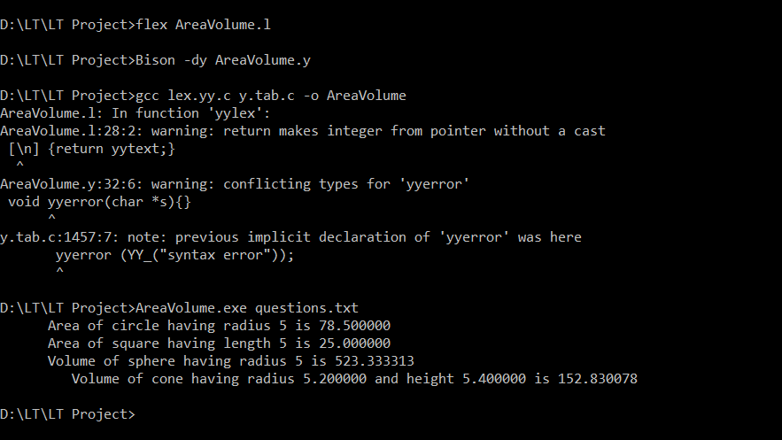
OUTPUT 1(Correct output)

Slide 7
questions.txt(With Error)
find area of circle having radius 5
find area of square having length 5
find volume of sphere having radius 5
fid volume of cone having radius 5.2 and height 5.4

Slide 8
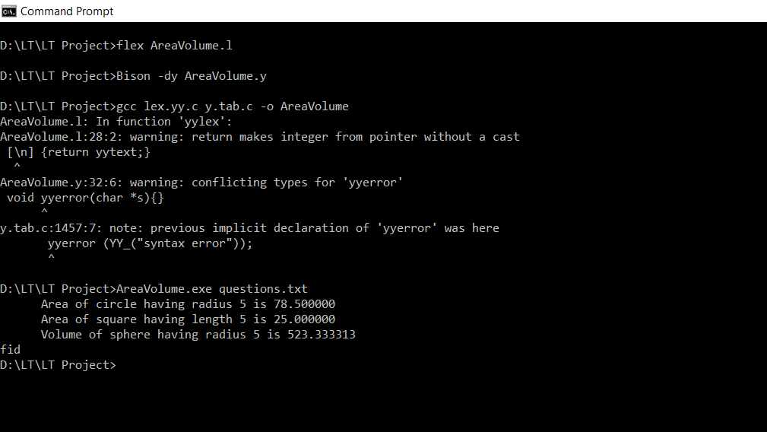
OUTPUT 2(Incorrect output due to erroneous input)

